Slide 1
Blink Detection using OpenCV
Dan Freve
02/17/2011

Slide 2
Overview
Problem/Goal
Attempted Methods
OpenCV
Image Subtraction
Haar Classifiers
Results
Future Improvement

Slide 3

Problem
Sleepy drivers cause many accidents
100,000 crashes from driver fatigue each year
1,550 deaths
71,000 people injured
Notes:
Source: http://www.car-accidents.com/driver-fatigue-fall-asleep.html
Some newer cars getting smart – starting to have saftey technology.

Slide 4
Goals
Warn drowsy drivers before they fall asleep
Use blinking to detect drowsiness
Use OpenCV for vision routines
Test algorithm on PC, then port to hardware

Slide 5
Method 1 – Image Subtraction
Subtract current image from previous cvAbsDiff()
Convert difference image to grayscale cvCvtColor()
Low-pass filter image cvSmooth()
Binarize image cvThreshold()
Notes:
cvAbsDiff(frame_copy, frame_eyes_prev, frame_eyes_diff);
cvCopy(frame_copy, frame_eyes_prev);
cvCvtColor(frame_eyes_diff, frame_eyes_gray, CV_RGB2GRAY);
cvSmooth(frame_eyes_gray, frame_eyes_smooth);
cvThreshold(frame_eyes_smooth, frame_eyes_bin, 16, 255, CV_THRESH_BINARY);

Slide 6
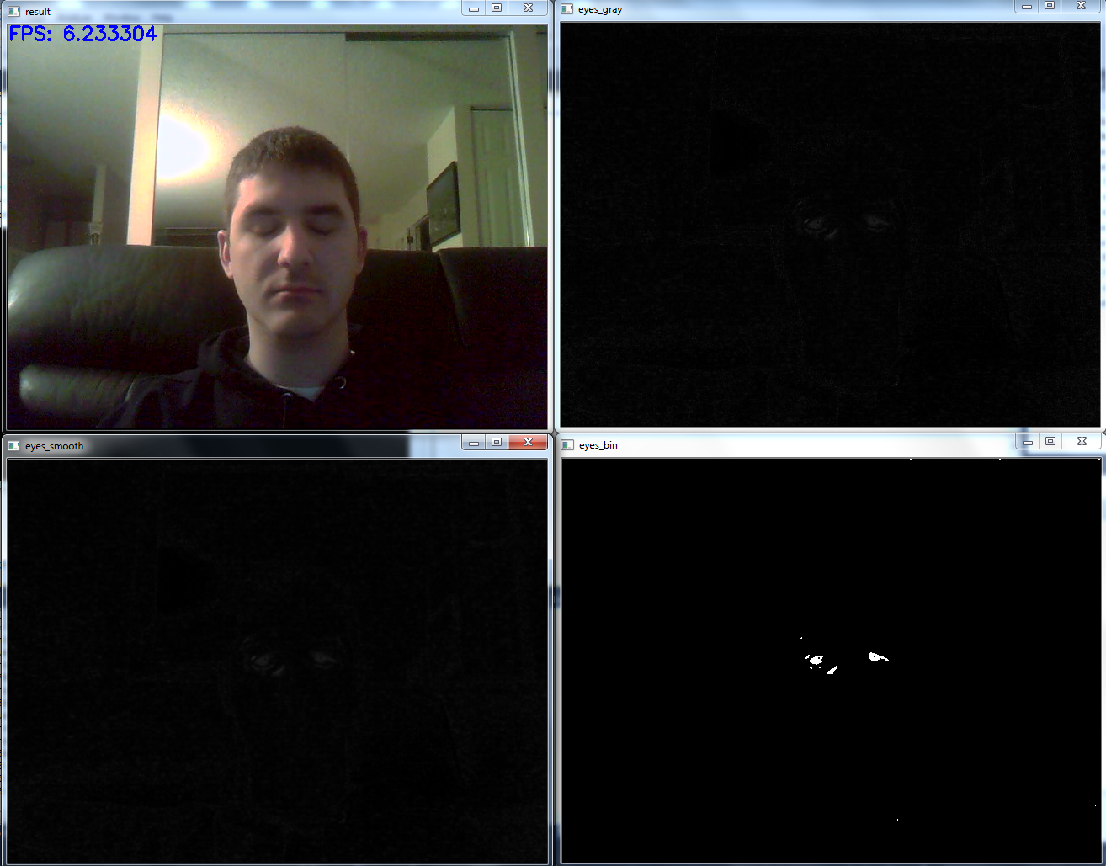
Method 1 – Image Subtraction

Slide 7
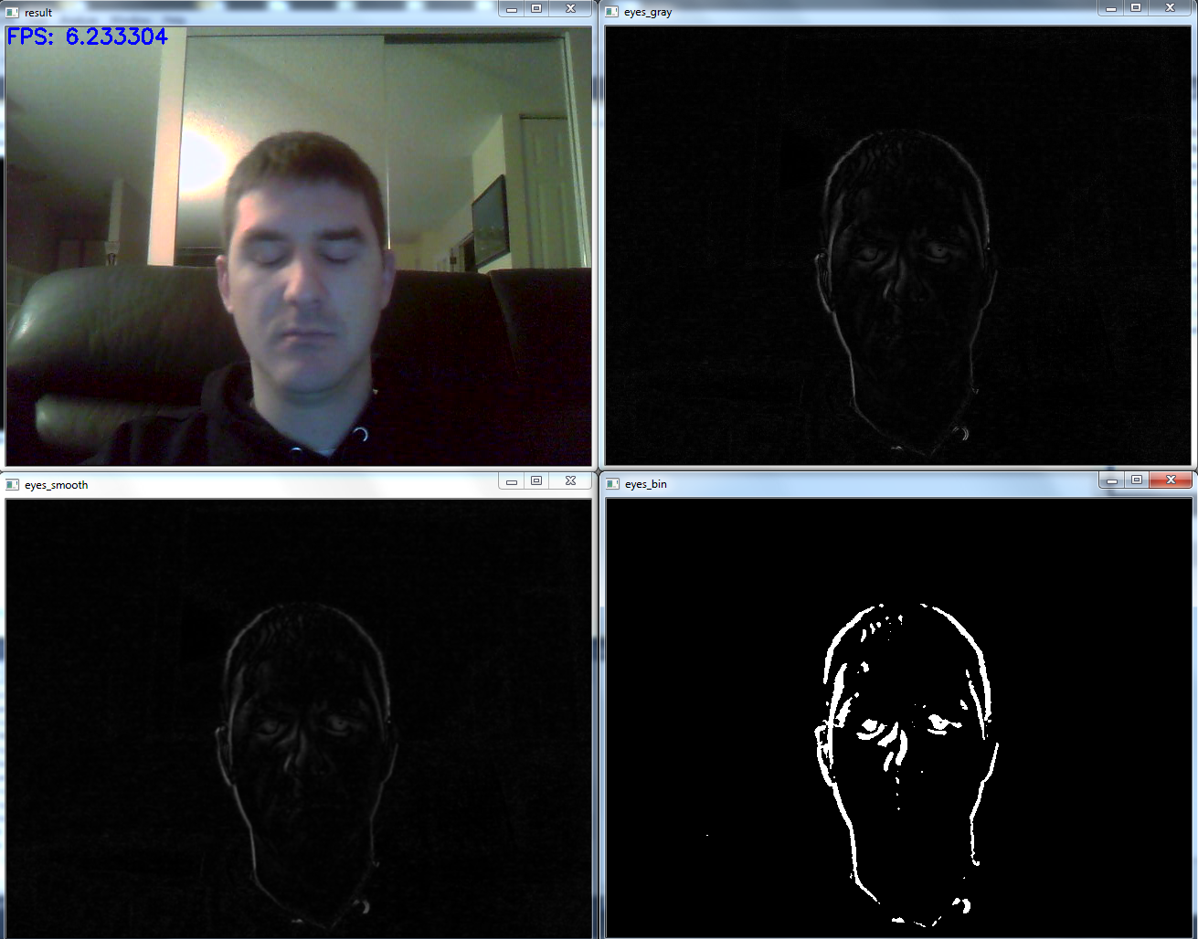
Method 1 – Image Subtraction

Slide 8
Method 1 – Image Subtraction
Pros
Simple Math
Processing time deterministic
Accurate (when subject still)
Cons
Does not work on individual still images
Can be sensitive to movement

Slide 9
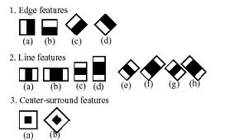
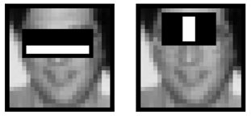
Method 2 – Haar Classifiers Overview
Adjacent rectangular regions
Difference of sum of pixels in a region
Identifies common edges, lines, etc.
“Staged” approach (fast rejection)
Notes:
A Haar-like feature considers adjacent rectangular regions at a specific location in a detection window, sums up the pixel intensities in these regions and calculates the difference between them. This difference is then used to categorize subsections of an image. For example, let us say we have an image database with human faces. It is a common observation that among all faces the region of the eyes is darker than the region of the cheeks. Therefore a common haar feature for face detection is a set of two adjacent rectangles that lie above the eye and the cheek region. The position of these rectangles is defined relative to a detection window that acts like a bounding box to the target object (the face in this case).

Slide 10
Method 2 – Haar Classifiers
Collect positive/negative samples object_marker(), create_samples.exe
Train haartraining.exe
Wait…
Evaluate (CvHaarClassifierCascade*)cvLoad() cvHaarDetectObjects()
Notes:
haarcascade_frontalface_alt.xml
(CvHaarClassifierCascade*)cvLoad
cvHaarDetectObjects

Slide 11
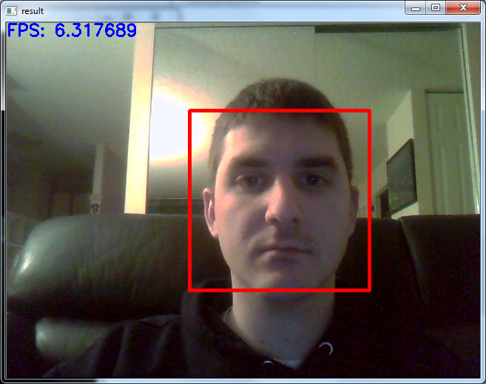
Method 2 – Haar Classifiers

Slide 12
Method 2 – Haar Classifiers
Pros
Very fast
Accurate
Generic
Cons
Training time
Requires 1000’s of sample images

Slide 13
Future Work
Improve Positive Image Set
Continue Haar training
Combine multiple classifier methods
Port to hardware
Open Source: https://danfreve-blinkdetection.googlecode.com/svn/trunk

Slide 14
Questions?

